Slide 1

Battle Evaluator
By: Cory Nelson

Slide 2
Project Proposal: Pokémon Battle Cory Nelson
About me:
CSCI Major with Aerospace Studies Minor
Air Force ROTC
AI:
I have no background in AI before CSCI 164
Interests:
Cyber Security
Gaming
Space

Slide 3
Problem
Find the best approach to a Pokémon battle
PEAS
Performance Measure: Win in fewest moves, with least amount of damage done to our own Pokémon
Environment: Pokémon Battle
Actuators: Game mechanics; the battle screen
Sensors: The Pokémon's’ current health are always on display; the game tells us if move is effective or not

Slide 4
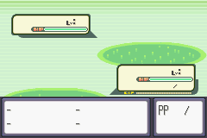
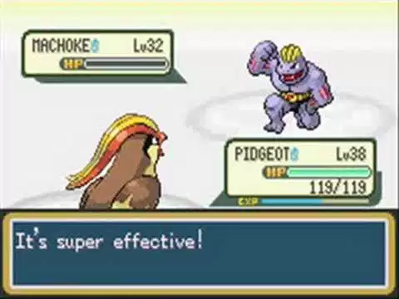
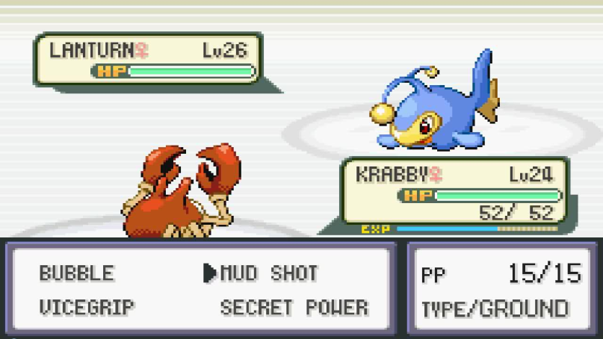
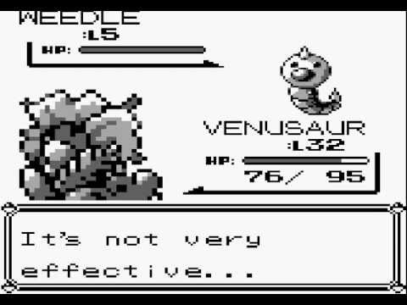
Battle Screen/Environment

Slide 5
Adversarial Search Approach
Minimax on a graph of moves during a battle
With Alpha- Beta Pruning
Heuristics:
Rank moves by effectiveness, i.e. super effective moves are higher valued that normal or not very effective moves

Slide 6
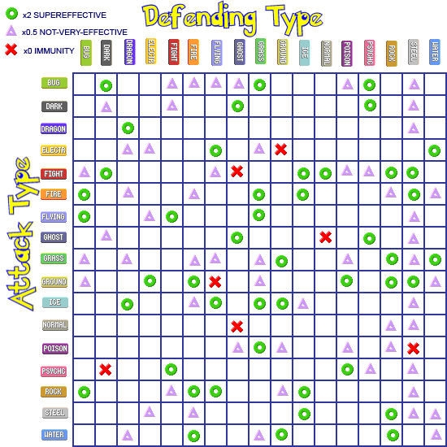

Slide 7
Evaluation Ideas
The shortest path to victory with that leads to the least damage to the Pokémon
So find the shortest branch of the graph which finds my Pokémon winning

Slide 8
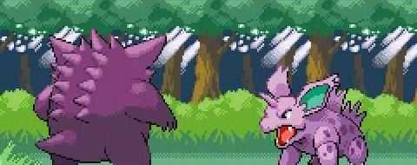
Questions

